Slide 1
Interpretation of Oregon State Data in 2020
Project Update -1
2231 CHE 2410 SEC1030 MATHMTCL METHD IN CHMCL ENGR 1
Lakshmi Yasodhara Ananthabhotla

Slide 2
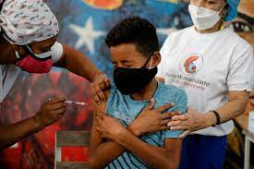


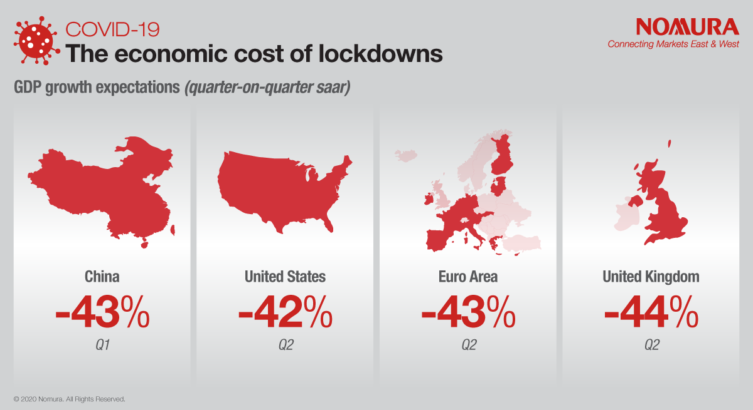

Covid-19 Pandemic
2020
https://www.who.int/news-room/commentaries/detail/transmission-of-sars-cov-2-implications-for-infection-prevention-precautions
Notes:
39th most densely populated state in the US.
Surpassed 20 million infections from SARS-CoV and more than 346,000 deaths in the United States alone!

Slide 3

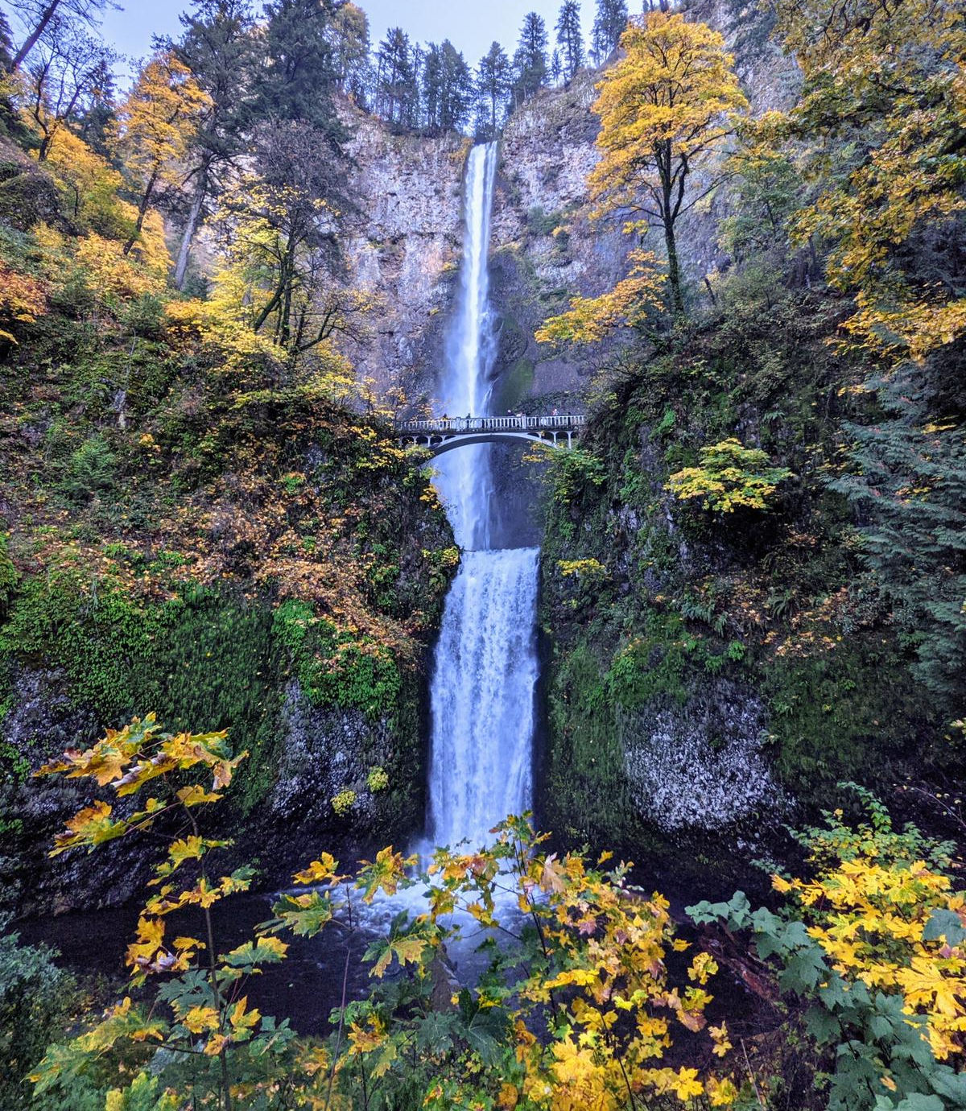
Why Oregon State?
A beautiful state with an area of 98,381 square miles
An average of 40 people per square mile ~ less densely populated
Notes:
39th most densely populated state in the US.

Slide 4
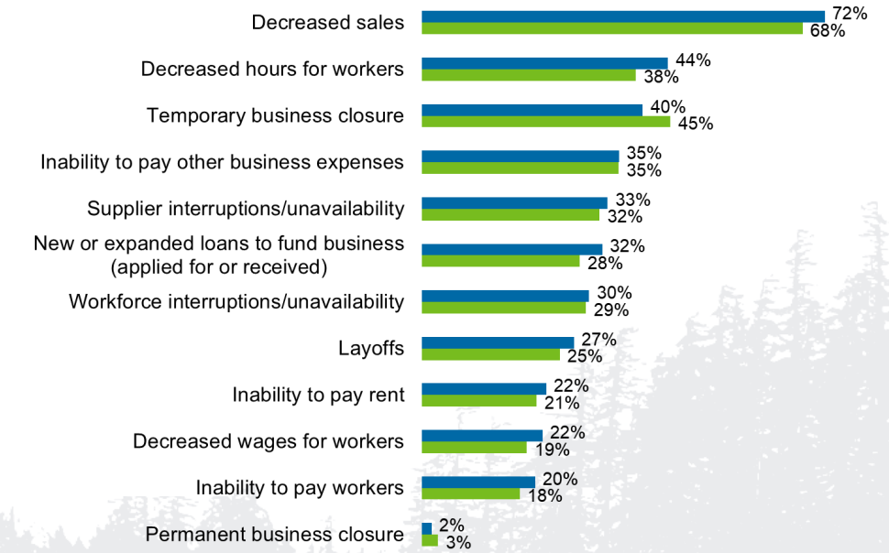
What makes it interesting?
The economic impacts of COVID-19 in Oregon included stock market losses for major companies like Intel, Nike, etc.
"28% of Oregon businesses saw revenue decline by 90% or more in April"
https://industry.traveloregon.com/wp-content/uploads/2020/05/COVID-19-Business-Survey-Results-4.30-FINALv5.pdf
Notes:
39th most densely populated state in the US.

Slide 5
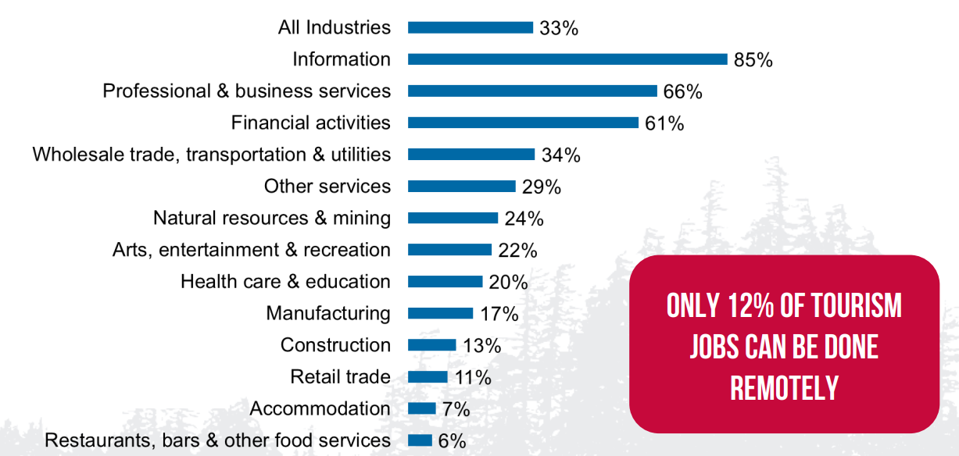
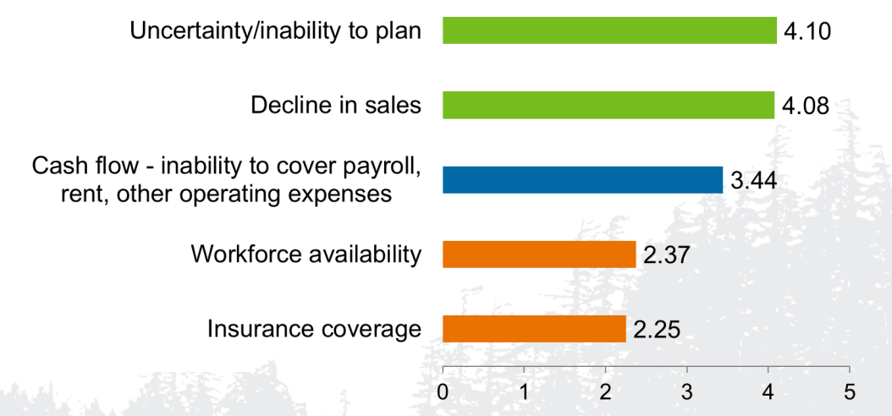
Previous Work
"Only 33% of Businesses Have Workforces that Can Work Remotely"
Uncertainty & Decline in Sales are the Biggest Challenges for Businesses During COVID-19
https://industry.traveloregon.com/wp-content/uploads/2020/05/COVID-19-Business-Survey-Results-4.30-FINALv5.pdf
Notes:
39th most densely populated state in the US.

Slide 6
Data Collection
SARS Covid-19 cases
Number of births in each county
Annual per capita income
https://www.oregon.gov/oha/ph/birthdeathcertificates/vitalstatistics/birth/pages/index.aspx
https://fred.stlouisfed.org/release/tables?rid=175&eid=268359
Notes:
39th most densely populated state in the US.

Slide 7
Objectives
How did the covid 19 pandemic effect the annual income in each county?
How did the covid 19 pandemic effect the number of births in each county?
Were there less number of births in counties where there was less annual income, during the pandemic?
Notes:
39th most densely populated state in the US.

Slide 8
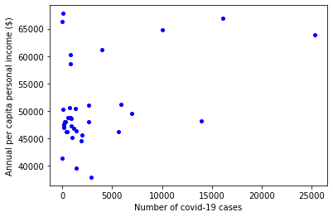
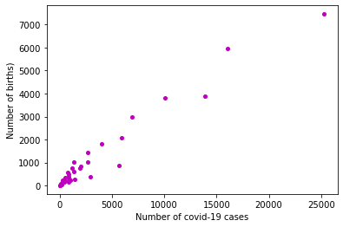
Data Representation
Figure: Scatter plot of collected Income data and Covid-19 data
Figure: Scatter plot of collected New Births data and Covid-19 data ​
​
Notes:
39th most densely populated state in the US.

Slide 9
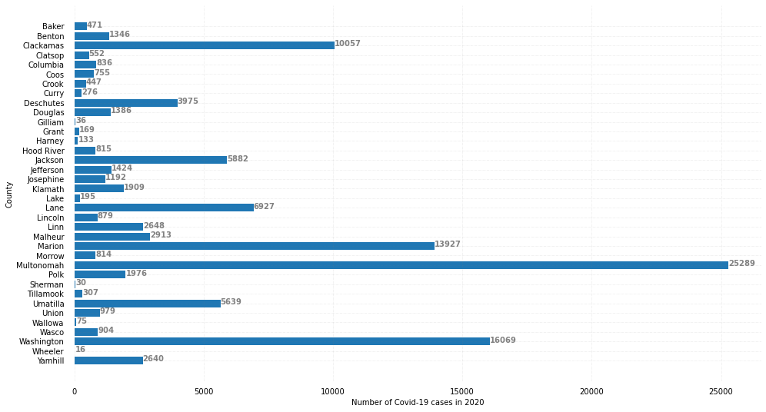
Data Representation
Figure: Bar plot of collected Covid-19 data (county-wise)
Notes:
39th most densely populated state in the US.

Slide 10
Data Analysis and Results
The following procedure was used to analyze the collected data:
Step – 1: Performed "Shapiro-Wilk" test if the data is normally distributed
Step – 2: Discretized my parametric data based on economic definitions
Step – 3: Performed "Mann-Whitney" U-test to compare the differences in the outcomes of the collected data
Step – 4: Performed liner-regression analysis to fit the discretized data with "Interaction" effects
Notes:
39th most densely populated state in the US.

Slide 11
Data Analysis and Results
First U-test:
Null Hypothesis - "More number of Covid-19 Cases in counties with less per capita income"
Result -
Second U-test:
Null Hypothesis - "More number of Covid-19 Cases in counties with less number of births"
Result -
P = 0.1760472
P =0.00000332
Notes:
39th most densely populated state in the US.

Slide 12
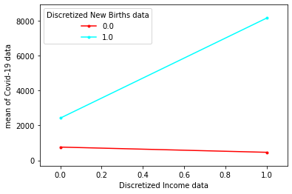
Data Analysis and Results
Linear Regression model:
Intercept : 762.5999
New births dependence parameter : 1657.8
Income dependence parameter : -298.0007
Interaction slope : 6015.4272
​
Figure: Interaction plot of the discretized data
Notes:
39th most densely populated state in the US.

Slide 13

Discussion
Conclusions from the statistical analysis:
A positive dependence of births data is observed
A negative dependence of income data is observed
A positive dependence of their interaction is noted
Notes:
39th most densely populated state in the US.

Slide 14
Next Steps
The following steps can be executed to obtain a better fit:
A non-linear model can be used to obtain a better fit
More data points can be collected, within the state, across years, to perform a better analysis
Notes:
39th most densely populated state in the US.

Slide 15
Thank You

